Slide 1


Analytic Insights for Ecology & Evolutionary Biology (EBIO) Molecular, Cellular & Developmental Biology (MCDB) Undergraduate Majors: Time To Degree, Retention Rates, Course Grade Distribution, and Course Sequencing - 5th Analysis -
Ali Oran, Ph.D.
CU BOULDER / ODA / INSTITUTIONAL RESEARCH
Wednesday, August 01, 2018
INSTITUTIONAL RESEARCH

Slide 2
With:
Robert Stubbs
Wednesday, August 1, 2018
INSTITUTIONAL RESEARCH
2

Slide 3
Outline:
March 07, 2018:
0. Preliminaries
Time to Degree & Retention Rates
Year Distribution of EBIO majors in Ancillary Classes (Chemistry, Physics, Mathematics)
Grade Distribution of EBIO majors in Ancillary Classes (Chemistry, Physics, Mathematics)
Course Sequencing (Flow) of Students
Seniors’ Needs
Other Indicators (Distribution of Credit Hours at Graduation)
For the next meeting
June 27, 2018:
0. Preliminaries (reiterated)
Students’ Progress (Forward Analysis)
Term-wise progress of Incoming Cohorts (Entry as EBIO, MCDB)
For the next meeting (reiterated)
postponed for now
August 01, 2018:
0. Preliminaries (reiterated)
Students’ Progress (Forward Analysis)
Term-wise progress of Incoming Cohorts (Entry & 1st Declared as EBIO, MCDB)
For the next meeting (reiterated)
April 25, 2018:
0. Preliminaries (reiterated)
Effects of “focus courses” on other course success (from April 05)
Students’ Progress (Forward Analysis)
Incoming Characteristics of Cohorts
Graduation Characteristics of Cohorts
Flow of Incoming Cohorts
For the next meeting (reiterated)
May 23, 2018:
0. Preliminaries (reiterated)
Students’ Progress (Forward Analysis)
Incoming Characteristics of Cohorts (EBIO, MCDB, A&S)
Graduation Characteristics of Cohorts (EBIO, MCDB, A&S)
Flow of Incoming Cohorts (EBIO, MCDB)
Flow of Incoming Cohorts with 1st year core classes (EBIO)
For the next meeting (reiterated)
Wednesday, August 1, 2018
INSTITUTIONAL RESEARCH
3

Slide 4
0. Preliminaries - Motivation:
Understanding Student Progress in EBIO Major:
Analyzing time to degree, retention rates, class distribution, and grade distribution of undergraduate EBIO students.
Analyzing the course sequencing (flow) of undergraduate EBIO students.
Wednesday, August 1, 2018
INSTITUTIONAL RESEARCH
4

Slide 5
0. Preliminaries – Data:
Secondary (Look-Forward):
EBIO 2004-2016 Summer/Fall Freshman Cohorts
(Full Time Entry)
Entered as EBIO
1st Declared as EBIO
Primary (Look-Back):
EBIO Spring 2017 Graduates,
Entered as Freshman in Summer/Fall
Time to Degree
Class Distribution of EBIO majors in Ancillary Classes
Grade Distribution of EBIO majors in Ancillary Classes
Course Sequencing (Flow) of Students
Other (Distribution of Credit Hours at Graduation)
Effects of focus courses’ on later course success (April 5th )
MARCH
Retention Rates
EBIO 2010-2017 Summer/Fall Freshman Cohorts
(Full & Part Time)
Entered as EBIO
Students’ Progress (Forward Analysis)
Incoming Characteristics of Cohorts
Retention and Graduation Characteristics of Cohorts
Flow of Incoming Cohorts
Term-wise progress of Incoming Cohorts (2010-2017)
APRIL, MAY, JUNE
First Declared as EBIO
Students’ Progress (Forward Analysis)
Term-wise progress of Incoming Cohorts (2010-2017)
JULY
Wednesday, August 1, 2018
INSTITUTIONAL RESEARCH
5

Slide 6
0. Preliminaries - Data:
EBIO 2010-2017 Fall/Summer Freshman Cohorts
Set of EBIO Majors:
First Declared as EBIO (Part-Time)
Entry as EBIO (Part-Time)
First Declared as EBIO (Full-Time)
Entry as EBIO (Full-Time)
Wednesday, August 1, 2018
INSTITUTIONAL RESEARCH
6

Slide 7
1. Students’ Progress (Forward Analysis):
Cohort Entry Years: 2010 - 2017
Summer/Fall Freshman, Full & Part Time Entry
Entry as Major
1st Declared as Major

Slide 8
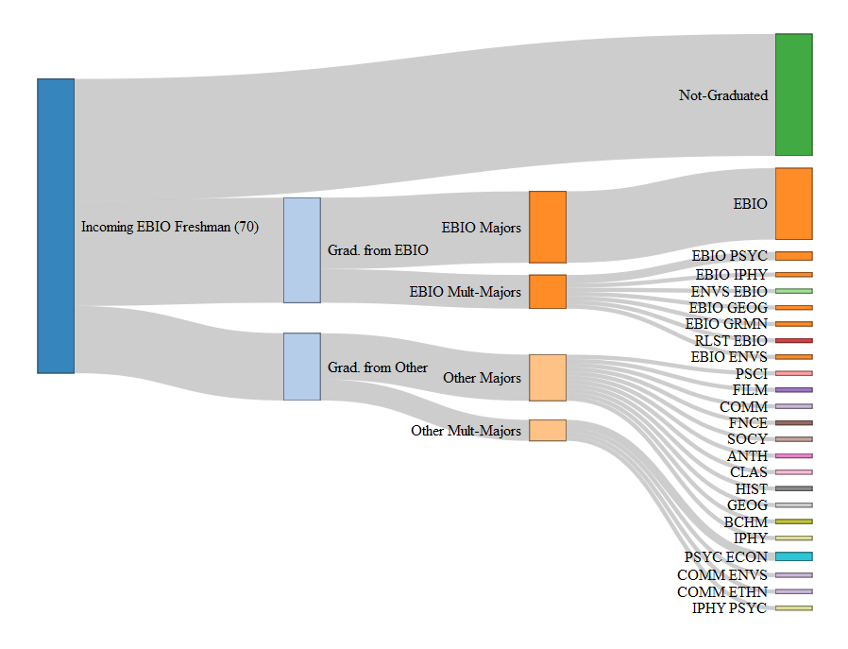
1. Students’ Progress:
1. 1. EBIO Cohort Progress Characteristics, 2010 (from April 25 , May 23):
Data Set: Secondary (Look-Forward):
EBIO Summer/Fall Freshman Cohort
Full & Part Time Entry
70 students
Wednesday, August 1, 2018
INSTITUTIONAL RESEARCH
8

Slide 9
1. Students’ Progress : 1. 2. EBIO Term Network (from May 23):
 | Entry (Fall 2010) | End of 1st Term: (Fall 2010) | End of 2nd Term: (Spring 2011) | End of 4th Term: (Fall 2011)
EBIO-Majors | 70 | 64 | 57 | 39
Other Majors | 0 | 6 | 9 | 14
Not Enrolled | 0 | 0 | 4 | 17
4
5
3
13
1
Wednesday, August 1, 2018
INSTITUTIONAL RESEARCH
9

Slide 10
1. Students’ Progress : 1. 3. EBIO & MCDB Cohort Progress (last meeting, June 27):
Take a detailed look in .html files (opened in Chrome browser)
EBIO / Cohorts: 2010, 2011, 2012, 2013, 2014, 2015, 2016, 2017
MCDB / Cohorts: 2010, 2011, 2012, 2013, 2014, 2015, 2016, 2017
Wednesday, August 1, 2018
INSTITUTIONAL RESEARCH
10

Slide 11
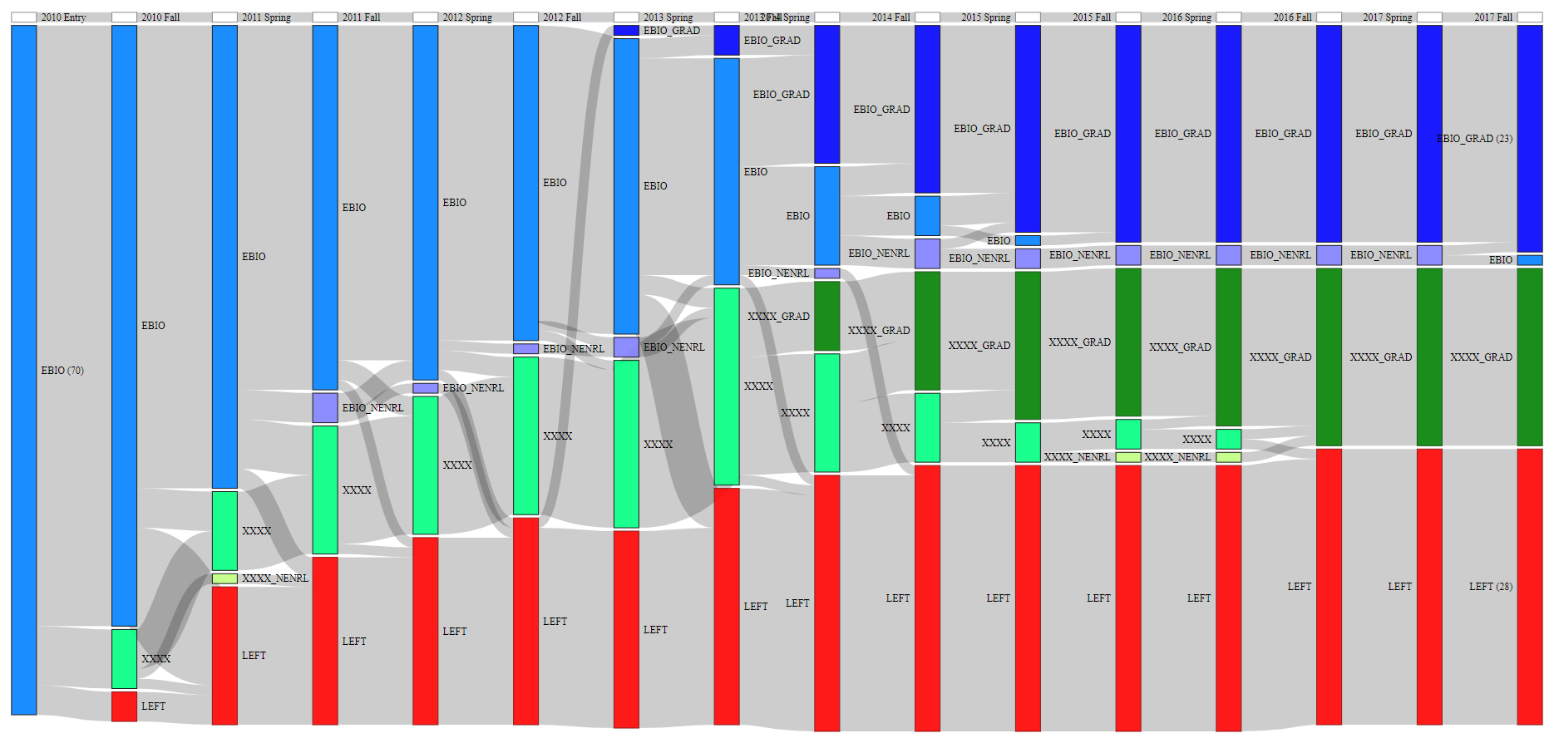
1. Students’ Progress : 1. 4. EBIO Cohort Progress, 2010 (last meeting, June 27):
Wednesday, August 1, 2018
INSTITUTIONAL RESEARCH
11

Slide 12
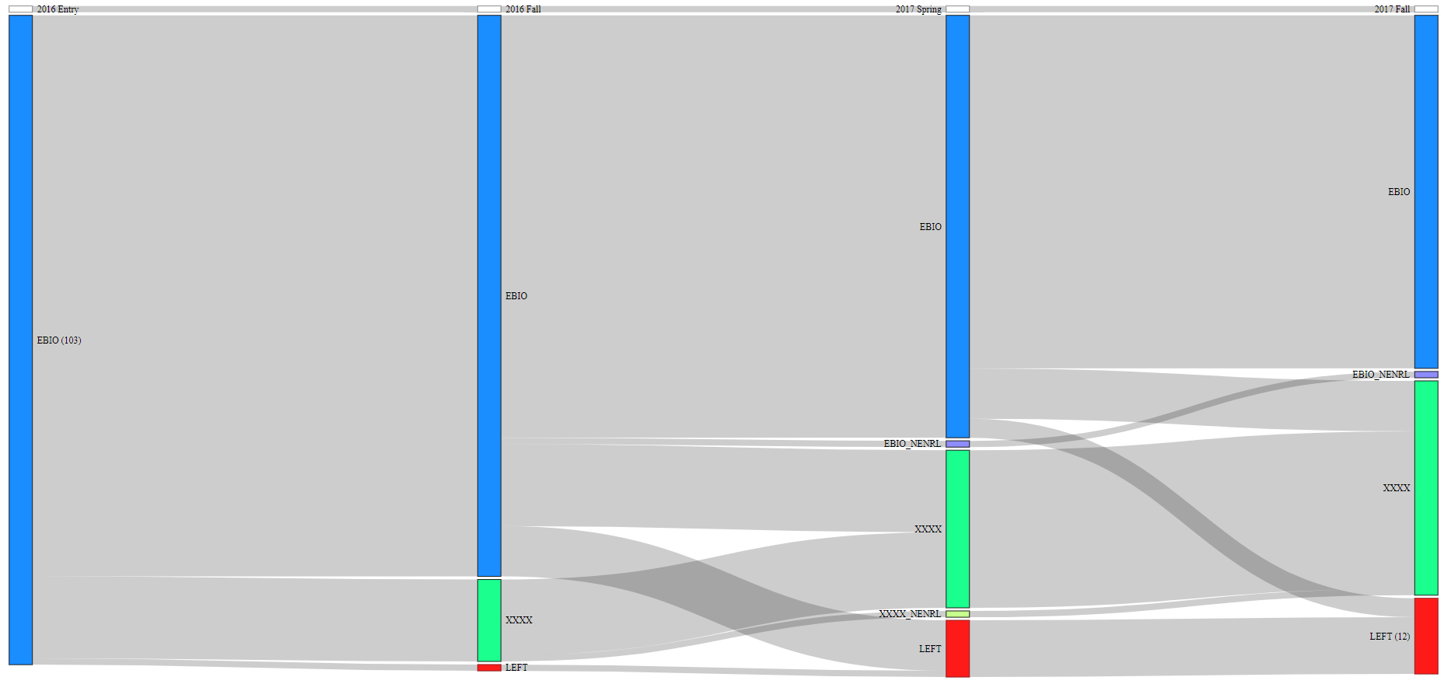
1. Students’ Progress : 1. 5. EBIO Cohort Progress, 2016 (last meeting, June 27):
Wednesday, August 1, 2018
INSTITUTIONAL RESEARCH
12

Slide 13
1. Students’ Progress : 1. 6. EBIO & MCDB Cohort Progress:
Include: 1st Declared Major to Entry Major
Curtail: Non-Enrolled students’ groups (Include them in their respective majors)
Color Standardization:
Group: | Color Code:
Years/Terms:
Students, 1st Declared & still Undeclared:
Students, In the major:
Students, Graduated from the major:
Students, In other majors:
Students, Graduated from the other majors:
Students, Graduated from the other majors with a 2nd major in EBIO
Students, Left:
shades of Blue
shades of Green
Wednesday, August 1, 2018
INSTITUTIONAL RESEARCH
13

Slide 14
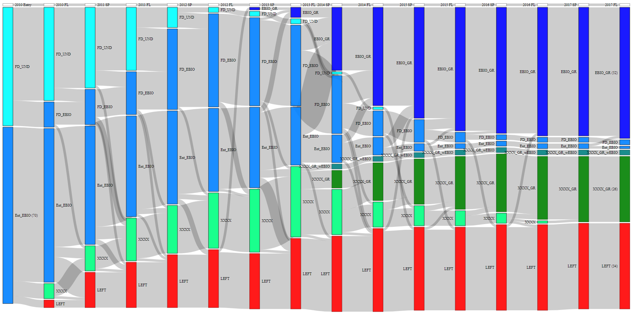
1. Students’ Progress : 1. 7. EBIO Cohort Progress, 2010: (inclusion of 1st Declared Major) v1
Total
# of Grads
for
Entry &
1st Dec.
Total
# of Leaves
for
Entry &
1st Dec.
Wednesday, August 1, 2018
INSTITUTIONAL RESEARCH
14

Slide 15
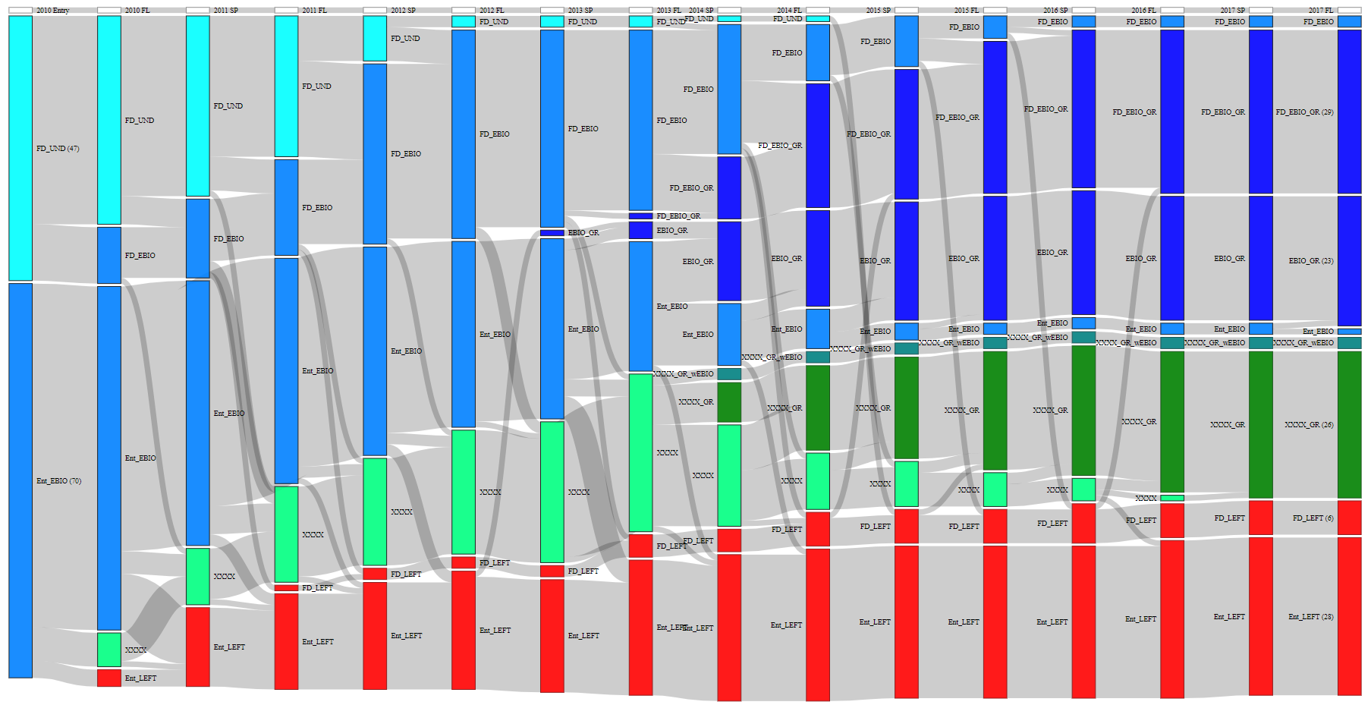
1. Students’ Progress : 1. 8. EBIO Cohort Progress, 2010: (inclusion of 1st Declared Major) v2
# of Grads
for 1st Dec.
# of Grads
for Entry
# of Leaves
for 1st Dec.
# of Leaves
for Entry
Wednesday, August 1, 2018
INSTITUTIONAL RESEARCH
15

Slide 16
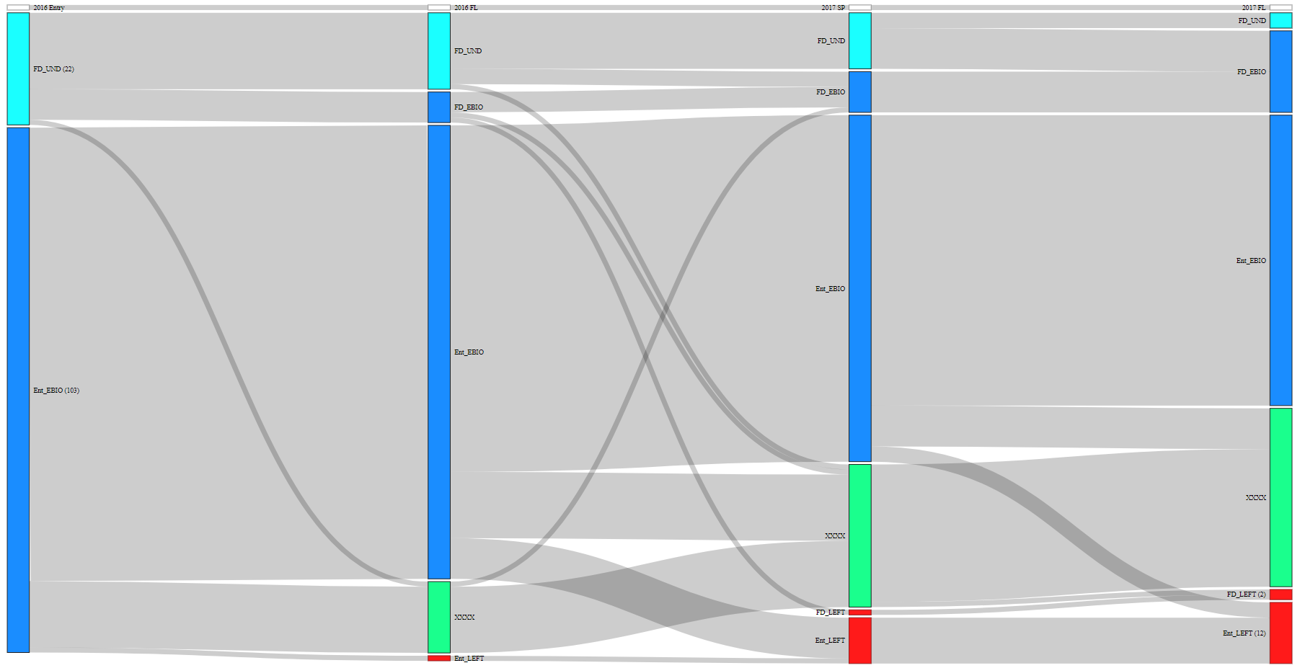
1. Students’ Progress : 1. 9. EBIO Cohort Progress, 2016: (inclusion of 1st Declared Cohort – v2)
Wednesday, August 1, 2018
INSTITUTIONAL RESEARCH
16

Slide 17
2. Students’ Progress : 1. 10. EBIO & MCDB Cohort Progress:
Let us take a detailed look in .html files (opened in Chrome browser)
EBIO / Cohorts: 2010, 2011, 2012, 2013, 2014, 2015, 2016, 2017
MCDB / Cohorts: 2010, 2011, 2012, 2013, 2014, 2015, 2016, 2017
Wednesday, August 1, 2018
INSTITUTIONAL RESEARCH
17

Slide 18
1. Students’ Progress : 1. 11. Some Insights:
Graduation in the Major %: (till end of 2017-Fall)
Entry Year | 2010 | 2011 | 2012 | 2013 | 2014 | 2015 | 2016 | 2017
Ent. as EBIO | 32.9 | 42.4 | 46.8 | 36.4 | 11.0 | 0 | 0 | 0
1st Dec. as EBIO | 61.7 | 46.7 | 60.0 | 41.5 | 11.4 | 0 | 0 | 0
Entry Year | 2010 | 2011 | 2012 | 2013 | 2014 | 2015 | 2016 | 2017
Ent. as MCDB | 33.3 | 27.4 | 29.0 | 25.9 | 4.2 | 0 | 0 | 0
1st Dec. as MCDB | 61.5 | 84.6 | 64.3 | 44.4 | 14.3 | 0 | 0 | 0
Bold: for cohort populations more than 20.
Wednesday, August 1, 2018
INSTITUTIONAL RESEARCH
18

Slide 19
1. Students’ Progress : 1. 11. Some Insights:
Leave %: (till end of 2017-Spring)
Entry Year | 2010 | 2011 | 2012 | 2013 | 2014 | 2015 | 2016 | 2017
Ent. as EBIO | 40.0 | 35.6 | 28.6 | 31.2 | 17.8 | 17.7 | 8.7 | 0
1st Dec. as EBIO | 12.8 | 23.3 | 16.0 | 12.2 | 5.7 | 8.3 | 4.5 | 0
Entry Year | 2010 | 2011 | 2012 | 2013 | 2014 | 2015 | 2016 | 2017
Ent. as MCDB | 25.7 | 30.4 | 32.5 | 27.8 | 26.9 | 13.5 | 11.2 | 0
1st Dec. as MCDB | 3.8 | 7.7 | 14.3 | 11.1 | 7.1 | 0 | 9.1 | 0
Bold: for cohort populations more than 20.
Wednesday, August 1, 2018
INSTITUTIONAL RESEARCH
19

Slide 20
2. For the Next Meeting: 2. 1. Needs:
Your feedback:
Things to update / add.
Finalize our work on each department’s particular needs.
Next Meeting:
Date: September 26, Wednesday?
Final Report:
Date: October 10, Wednesday?
Deliverables: Detailed on the next page.
Wednesday, August 1, 2018
INSTITUTIONAL RESEARCH
20

Slide 21
2. For the Next Meeting: 2. 1. Needs:
Final Report -Deliverables:
Time to Degree & Retention Rates
Year Distribution of EBIO majors in Ancillary Classes (Chemistry, Physics, Mathematics)
Grade Distribution of EBIO majors in Ancillary Classes (Chemistry, Physics, Mathematics)
Course Sequencing (Flow) of Students – Entry Majors of Graduates
Other Indicators (Distribution of Credit Hours at Graduation)
Effects of “focus courses” on other course success (from April 05)
Incoming Characteristics of Cohorts (Gender, Ethnicity, Index Score etc.) (EBIO, MCDB, A&S)
Graduation Characteristics of Cohorts (Gender, Ethnicity, Index Score etc.) (EBIO, MCDB, A&S)
Flow of Incoming Cohorts (1st Sankey, Entry-Graduation Major Patterns)
Term-wise progress of Incoming Cohorts (Entry & 1st Declared as EBIO, MCDB)
Seniors’ Needs?
Wednesday, August 1, 2018
INSTITUTIONAL RESEARCH
21

Slide 22
Thank you…
For questions:
Ali Oran: ali.oran@colorado.edu
Robert Stubbs: robert.stubbs@colorado.edu
Wednesday, August 1, 2018

